Slide 1

The Three Branches
of the
United States
Government

Slide 2
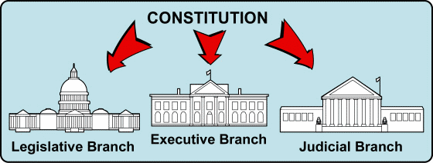
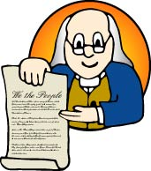
Over 200 years ago, our Founding Fathers wrote the Constitution. The Constitution is the written plan for how our government should work.
The Constitution divides the national or federal government into the following three branches: the legislative, executive, and judicial branches.

Slide 3

Who works in each branch of the national government?

Slide 4
Let’s look more closely at each branch of the National or Federal government.

Slide 5
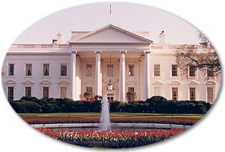

National Government:
The Executive Branch
President Barack Obama
The executive branch makes sure people follow the laws that
the legislative branch makes.
The leaders of this branch are the President and Vice-President.
When making important decisions, the President often asks for
advice from the Cabinet.
The President lives at the White House in Washington, D.C.

Slide 6
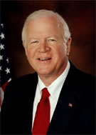
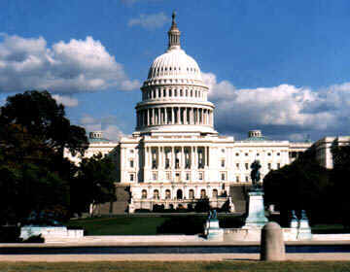
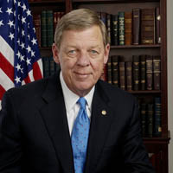
National Government:
The Legislative Branch
Senator Saxby Chambliss
Senator Johnny Isakson
They make laws for the whole country.
The main group is known as Congress.
Congress is made up of two parts, the House of Representatives
and the Senate.

Slide 7



How do Congress and the President work together to create laws?

Slide 8
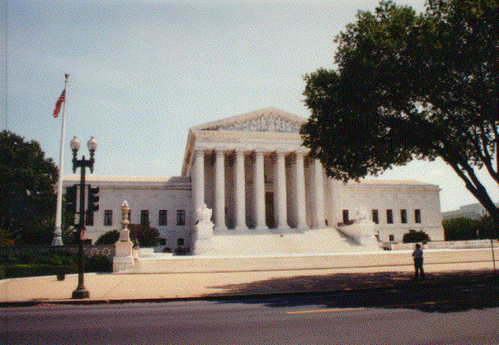
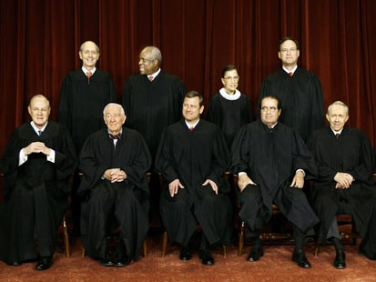
National Government:
The Judicial Branch
The Nine Justices of the Supreme Court
When people are unsure about the meaning of a law, the judicial
branch listens to many opinions and makes a decision.
The judicial branch is made up of courts.
The highest of these courts is the U.S. Supreme Court.

Slide 9
Let’s look more closely at each branch of State government.

Slide 10
State Government
Each state has its own constitution based on its unique history, needs, philosophy, and geography.
Just like the national government, each state's constitution separates power between three branches -- legislative, judicial, and executive.

Slide 11
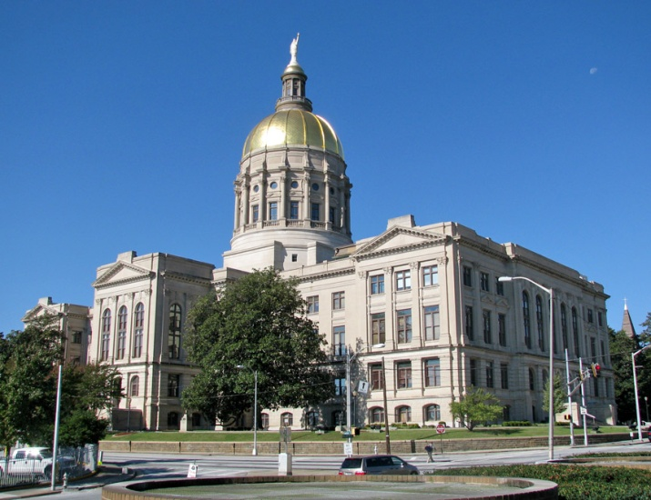

State Government:
The Executive Branch
Governor Sonny Perdue
The leader of the state executive branch is the Governor.
In Georgia, our leader is Governor Sonny Perdue. He does many of the same jobs as a president, but he does them at the state level.
The governor’s office, as well as the chambers of the state General Assembly are located at the capital (shown above).

Slide 12

State Government:
The Legislative Branch
In Georgia, our legislative branch is called the General Assembly.
The General Assembly is made up of two parts.
The General Assembly writes and passes laws that are just for the state of Georgia.

Slide 13

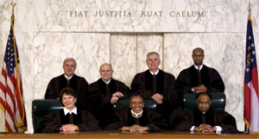
State Government:
The Judicial Branch
The Seven Justices of the Georgia Supreme Court
The state of Georgia has many courts that make decisions about state laws that have been broken. The highest court in the state of Georgia is the Georgia Supreme Court.

Slide 14
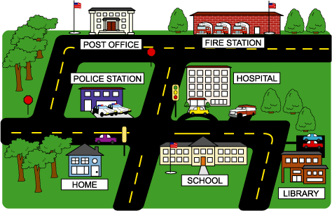
Let’s look more closely at each branch of the Local government.

Slide 15

Local Government: Executive Branch
Mayor of Lilburn
Diana Preston
In our city, the city of Lilburn, the leader of our executive branch is the mayor.
The mayor makes plans and decisions for the good of the city. The mayor also hears the opinions of the people who live in the city.
The mayor works together with the city council to keep the city running smoothly.

Slide 16
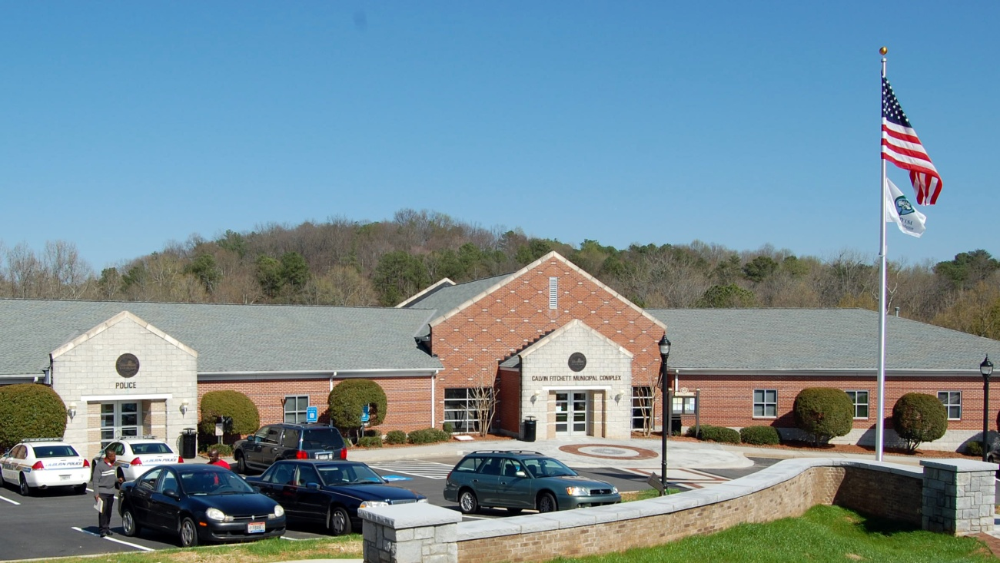
Local Government: Legislative Branch
The city council keeps the city running smoothly by working with the mayor to make decisions that will make life better for all the people living in the city.
Sometimes they make rules called ordinances to keep things peaceful and safe in the city.

Slide 17
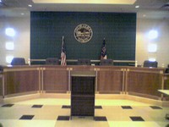
Local Government: Judicial Branch
Local courts make up the local judicial branch. Our local court is the Lilburn Municipal Court.
People go to this court if they are given a ticket for breaking the law in the city of Lilburn.

Slide 18



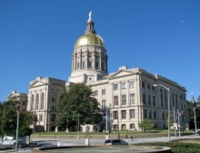

EXECUTIVE
LEGISLATIVE
JUDICIAL
Congress
The Supreme Court and other Federal Courts
President
Governor
General Assembly
The Georgia Supreme Court and other state courts
City Council
Mayor
Local Courts

Slide 19
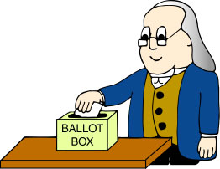
U.S. citizens can participate in their government. This process ensures that power will always remain where it belongs - with the people.
The most important right citizens have is the right to vote. By voting, the people have a voice in the government. The people decide who will represent them in the government.

Slide 20
Let’s play
Which Branch?
Barack Obama
EXECUTIVE
LEGISLATIVE
JUDICIAL

Slide 21
Let’s play
Which Branch?
The Georgia State Supreme Court
EXECUTIVE
LEGISLATIVE
JUDICIAL

Slide 22
Let’s play
Which Branch?
The Senate
EXECUTIVE
LEGISLATIVE
JUDICIAL

Slide 23
Let’s play
Which Branch?
The General Assembly
EXECUTIVE
LEGISLATIVE
JUDICIAL

Slide 24
Let’s play
Which Branch?
I think my state should pass a law making it illegal to move and leave your dog behind. Who should I write a letter to so that I can suggest this law?
EXECUTIVE
LEGISLATIVE
JUDICIAL

Slide 25
Let’s play
Which Branch?
We want the city of Lilburn to build a swimming pool at Lilburn Park. Who can we call to make this suggestion?
EXECUTIVE
LEGISLATIVE
JUDICIAL

Slide 26
Let’s play
Which Branch?
A man is driving to Florida for vacation. He is driving too fast on the highway and gets a speeding ticket. Which branch of Florida’s government will he report to so he can take care of his ticket?
EXECUTIVE
LEGISLATIVE
JUDICIAL

Slide 27
Let’s play
Which Branch?
All teachers in Georgia just received a raise. Who should they thank for paying them more money?
EXECUTIVE
LEGISLATIVE
JUDICIAL

Slide 28
Let’s play
Which Branch?
A woman in Gwinnett County stole something from Wal-Mart. The police catch her and take her to jail. When she goes to court what branch of government will take care of her trial?
EXECUTIVE
LEGISLATIVE
JUDICIAL

Slide 29
Let’s play
Which Branch?
This branch makes laws for the
country.
EXECUTIVE
LEGISLATIVE
JUDICIAL

Slide 30
Let’s play
Which Branch?
This branch includes 9 judges who make very important court decisions that affect our whole country.
EXECUTIVE
LEGISLATIVE
JUDICIAL

Slide 31
Let’s play
Which Branch?
A new law was written making it illegal to type text messages while driving anywhere in America.
Which branch of government wrote the law?
EXECUTIVE
LEGISLATIVE
JUDICIAL

Slide 32

You are correct!
Next Question

Slide 33

You are correct!
Next Question

Slide 34

You are correct!
Next Question

Slide 35

You are correct!
Next Question

Slide 36

You are correct!
Next Question

Slide 37

You are correct!
Next Question

Slide 38

You are correct!
Next Question

Slide 39

You are correct!
Next Question

Slide 40

You are correct!
Next Question

Slide 41

You are correct!
Next Question

Slide 42

You are correct!
Next Question

Slide 43

You are super smart!
THE END

Slide 44

Try it again!
Go Back

Slide 45
Try it again!
Go Back

Slide 46
Try it again!
Go Back

Slide 47
Try it again!
Go Back

Slide 48
Try it again!
Go Back

Slide 49
Try it again!
Go Back

Slide 50
Try it again!
Go Back

Slide 51
Try it again!
Go Back

Slide 52
Try it again!
Go Back

Slide 53
Try it again!
Go Back

Slide 54
Try it again!
Go Back

